Slide 1
Teacher Knowledge of Phonemic Awareness and Instruction:
Developing Proficient Early Readers
Dana Harris, PhD
harrisdm@puyallup.k12.wa.us

Slide 2
About Me…
Wife, Mother and Grandmother
Educator for 36 years
Director of Instructional Leadership
--K-12 Literacy
--Libraries
--Early Learning

Slide 3
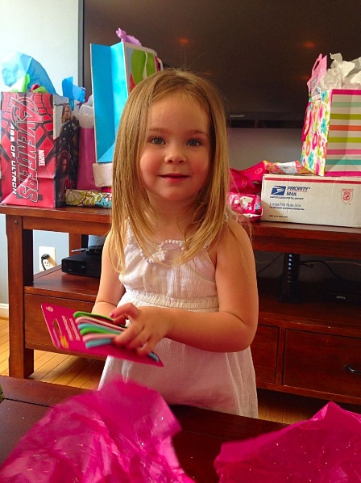
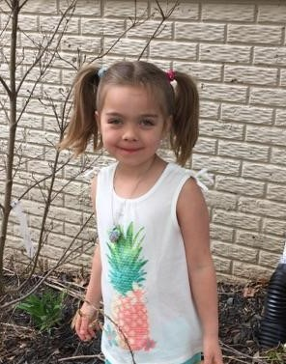





Slide 4
Today’s Learning Targets…
Our Knowledge About Phonemic Awareness
What is Phonemic Awareness?
Phase Theory
Activities to Build Phonemic Awareness

Slide 5

So what is phonemic awareness… and why is it important?

Slide 6
Let’s test our own knowledge about phonemic awareness…

Slide 7
Is phonemic awareness…
The same as phonics
The understanding of the relationship between
letters and the sounds they represent
The ability to identify and work with the individual
sounds in spoken words

Slide 8
So what is a phoneme… and why is it important?

Slide 9
Is a phoneme…
The smallest part of written language
The word part the contains a vowel sound
The smallest part of spoken language

Slide 10
Effective phonemic awareness instruction teaches children to…

Slide 11
Convert letters or letter combinations into sounds
Discriminate one letter from the other letters of the
alphabet
Detect, think about, and work with sounds in
spoken language

Slide 12
Beginning lessons in phonemic awareness involve…

Slide 13
Learning letter-sound relationships
Identifying sounds shared among words
Matching spoken words with printed words

Slide 14
Activities in phonemic awareness include…

Slide 15
Counting the sounds in the word “bake”
Coloring the pictures that begin with the “letter b”
Counting the syllables in the word “baseball”

Slide 16
An example of explicit phonemic awareness instruction is…

Slide 17
Choosing the word in a set of four words that has
the “different" sound
Teaching letter-sound correspondences
Reading words in the same word family, e.g., it, sit,
fit, hit

Slide 18
Which activity explicitly links spelling with phonemic awareness?

Slide 19
Make as many words as you can using only the letters
t, a, n, l
Say a word, then name the letters out loud; write the
word
Say a word, then tap out the sounds in the word; write
the letters for these sounds

Slide 20
Which task requires more refined phonemic awareness?

Slide 21
What is the first sound in shut?
What is the first sound in sidle?
The tasks are the same.

Slide 22
Phonemic awareness instruction…

Slide 23
Benefits most children in kindergarten and
first grade
Is only meant for students at-risk for reading failure
Is not appropriate for older students (7+ years old) who
have reading problems

Slide 24
Can the words shoe, do, blew, and you be used to illustrate oral rhyming?

Slide 25
Yes
No
Only you, do, and shoe, but not blew

Slide 26
Which of the following is an example of words with the same final sound?

Slide 27
house-hose
of-off
please-buzz

Slide 28
Which of the following is an example of grouping words with a common vowel sound?

Slide 29
fin, fist, find
read, bread, bead
son, blood, touch

Slide 30
You are helping students break a word into its separate sounds.
How many sounds are in the word bride?

Slide 31
Three
Four
Five

Slide 32
Which list shows a systematic sequence in counting sounds in words from easy to complex?

Slide 33
cap, chap, chaps
me, bee, bleep
ate, late, slate

Slide 34
If you said the word faxed without the sound /k/, you would say…

Slide 35
Fad
Fit
Fast

Slide 36

So how do you think you did?

Slide 37
Results
Survey on Phonemic Awareness, Knowledge, and Skills
Average score of 11 items correct
Range of 3 to 14 items correct

Slide 38
Results
No perfect scores of 15
9 teachers (26%) scored below 25th percentile
12 teachers (34%) scored between 26th and 50th percentile

Slide 39
Results
11 teachers (31%) scored between 51st and 75th
percentile
3 teachers (9%) scored above 75th percentile
60% of kindergarten teachers scored below 50th percentile

Slide 40
Phonemic awareness is…
The same as phonics
The understanding of the relationship between
letters and the sounds they represent
The ability to identify and work with the
individual sounds in spoken words

Slide 41
A phoneme is…
The smallest part of written language
The smallest part of spoken language
The word part the contains a vowel sound

Slide 42
Effective phonemic awareness instruction teaches children to…

Slide 43
Convert letters or letter combinations into sounds
Discriminate one letter from the other letters of the
alphabet
Detect, think about, and work with sounds in
spoken language

Slide 44
Beginning lessons in phonemic awareness involve…

Slide 45
Learning letter-sound relationships
Identifying sounds shared among words
Matching spoken words with printed words

Slide 46
Results
When required teachers to identify a phonemic awareness lesson--
Sixty-eight percent answered correctly while 12
kindergarten teachers chose the phonics foil, learning
letter-sound relationships, 100% of the time.

Slide 47
Activities in phonemic awareness include…

Slide 48
Counting the sounds in the word “bake”
Coloring the pictures that begin with the “letter b”
Counting the syllables in the word “baseball”

Slide 49
An example of explicit phonemic awareness instruction is…

Slide 50
Choosing the word in a set of four words that has
the “different" sound
Teaching letter-sound correspondences
Reading words in the same word family, e.g., it, sit,
fit, hit

Slide 51
Results
When teachers answered incorrectly on questions 1-4, they selected the phonics foil 100% of the time.
Teachers selected the phonics foil one-third of the time for question 5 and two-thirds of the time for question 6.

Slide 52
Results
When asked for an example of explicit phonemic awareness instruction--
Forty-six percent of kindergarten teachers answered this question correctly.
Once again, the phonics foil was chosen 67% of the time as an incorrect answer.

Slide 53
Which activity links spelling with phonemic awareness?

Slide 54
Make as many words as you can using only the letters
t, a, n, l
Say a word, then name the letters out loud; write the
word
Say a word, then tap out the sounds in the word;
write the letters for these sounds

Slide 55
Which task requires more refined phonemic awareness?

Slide 56
What is the first sound in shut?
What is the first sound in sidle?
The tasks are the same.

Slide 57
Results
When asked to select the task demonstrating the more refined phonemic awareness skill--
Only four (11%) teachers were correct.
Kindergarten teachers were split in their incorrect responses.

Slide 58
Phonemic awareness instruction…

Slide 59
Benefits most children in kindergarten
and first grade
Is only meant for students at-risk for reading failure
Is not appropriate for older students (7+ years old) who
have reading problems

Slide 60
Can the words shoe, do, blew, and you be used to illustrate oral rhyming?

Slide 61
Yes
No
Only you, do, and shoe, but not blew

Slide 62
Which of the following is an example of words with the same final sound?

Slide 63
house-hose
of-off
please-buzz

Slide 64
Results
When asked to match two words with the same final sound--
Seventy-seven percent of kindergarten teachers chose house-hose as the incorrect answer rather than the correct answer please-buzz.
Teachers had 54% accuracy.

Slide 65
Which of the following is an example of grouping words with a common vowel sound?

Slide 66
fin, fist, find
read, bread, bead
son, blood, touch

Slide 67
You are helping students break a word into its separate sounds.
How many sounds are in the word bride?

Slide 68
Three
Four
Five

Slide 69
Which list shows a systematic sequence in counting sounds in words from easy to complex?

Slide 70
cap, chap, chaps (3 sounds, 3 sounds, 4 sounds)
me, bee, bleep (2 sounds, 2 sounds, 4 sounds)
ate, late, slate (2 sounds, 3 sounds, 4 sounds)

Slide 71
If you said the word faxed without the sound /k/, you would say…

Slide 72
Fad
Fat
Fast

Slide 73
Results
When asked to recognize what is left of a word after deleting an individual sound from that word--
Teachers responded correctly 49% of the time.
Notes:
The Survey of Teacher PhAKS (Phonemic Awareness, Knowledge, and Skills) included nine items assessing teacher knowledge about phonemic awareness instruction with the first six items containing a foil which was an answer better describing phonics (Cheesman et al., 2009). The last six items in the survey assessed key skills in phonological awareness.

Slide 74
Seventy-one percent of teachers in this study had from
6 to 20 plus years of teaching experience;
however, the 37 participating teachers
demonstrated an overall lack of deep knowledge
about phonemic awareness.

Slide 75
38% of teachers demonstrated what would be considered mastery of phonemic awareness.
60% of teachers scored below the 50th percentile on the survey of skills.
Teachers seemed confused by the phonics foils in questions.

Slide 76
Difficulty noting the difference between digraphs such as the /sh/ which represent one sound and blends /gr/ which represent two sounds
Some incorrect answers appeared to be a result of spelling miscues provided in the incorrect answers such as /house-hose/ instead of the correct answer /please-buzz/

Slide 77

How did you do?
Share with a neighbor…
Any ah hahs?

Slide 78

Confusion exists between phonemic
awareness which is the
recognition of sounds in spoken
language and phonics the speech
sounds used in reading and spelling.

Slide 79
“Even with best intentions from educators, lack of
knowledge of phonemic awareness makes it difficult
for young children to acquire necessary skills.”
(Cheesman et al., 2009; Moats, 2011)

Slide 80

More specifics about phonological awareness and phonemic awareness…

Slide 81
Why?
Opportunity gaps appear early, with children from
poor families entering school less prepared than
their kindergarten classmates.
(Dynarski, 2015)

Slide 82
Kindergarten students who perform below
standard in reading proficiency, and
particularly phonological skills, rarely close
the achievement gap.
(Kaminski & Good III, 2011)

Slide 83

Phonological awareness
is best defined as the ability to analyze the sound structure of words
Phonemic awareness is the ability to identify and manipulate the smallest sound pieces in words, the phonemes
Notes:
Some background knowledge

Slide 84
Phonemic awareness is a predictor of
reading acquisition and future reading
success.
(Carlson et al., 2013; Kaminski & Good III, 2012; Ouellette & Haley, 2013)

Slide 85
Phonological and Phonemic Awareness
The terms phonological awareness and phonemic
awareness are often used interchangeably.
Phonological awareness is the broader concept with
phonemic awareness as a part.

Slide 86
Phonological and Phonemic Awareness
Phonological awareness is the sensitivity to the sound
structure of words including syllables and rhyme
Phonological awareness, as a causal factor in reading
development, is a controversial topic.

Slide 87
The amount of reading research is vast.
Researchers and educators have focused with increasing
urgency over the several decades on teaching all students
to read well.
Specific skills may be more critical than others such as
letter naming or sounding out words.

Slide 88
How does phonological awareness develop?
Phonological skills are a part of normal language
development.
The relationship between phonological awareness and
reading has been supported by four decades of research.

Slide 89
Phonological and Phonemic Awareness
In its purest form, phonological awareness does not
involve print.
Phonological awareness tasks require children to analyze,
make judgments about, and manipulate the sounds in
spoken words.

Slide 90
Languages are made up of approximately 40 distinct
elements called phonemes that alter a word’s meaning
such as rat to bat in English.
Infants must sort through all the sounds available to
discover the specific sounds associated with their native
language.

Slide 91

If students can distinguish between the
40 phonemes, then
children have already achieved steps
toward becoming
literate before being introduced to the written form of the language.

Slide 92
A strong correlation exists between preschool
language development and future success in school.
Language is learned by children as they interact with
others in a variety of activities.
Children then take these interactions and incorporate the
feedback into their developing language skills.

Slide 93
Continuum of Skills
Only
phoneme
skills
Includes all phonological awareness skills including phonemes, onsets, and rime
The capacity to identify and manipulate syllables as well as onsets, rimes, codas, and phonemes
Refers to phonological sensitivity including words, syllables, onsets, rimes, and phonemes

Slide 94
Phonemic Awareness Is…
the ability to recognize and segment the phonemes which
comprise spoken language.
a critical subset of skills included in the larger category of
phonological awareness.
the processing ability most closely related to early literacy
acquisition.

Slide 95
Phonemic Awareness
Phonemic awareness includes the ability to manipulate
individual phonemes in words, along with oral rhyme,
alliteration, syllables, onsets, and rimes.

Slide 96
Phonemic Awareness is…
Interconnected with the development of speech sounds in
young children and the development of specific
phonemes which become the building blocks of words
“bat” has three phonemes or sounds: /b/ /a/ /t/
“rake” also has three phonemes: /r/ /a/ /k/

Slide 97
Phonemic Awareness
Phonemic awareness is the awareness of sounds, not
letters.
Even though “rake” has four letters, you only hear three
phonemes or sounds when the word is spoken.

Slide 98
Phonemic Awareness
Phonemic awareness complexity is indicated by the
number of phonemes in a word; the greater the number
of phonemes, the higher the complexity.
Phoneme segmentation is the ability to divide a word
into its sounds while phoneme synthesis is the ability to
blend sounds together to make a syllable or word.

Slide 99
Phonemic Awareness
Breaking words up into individual sounds is an easy task
for adults; however it is very difficult for young children.
Dividing words into their phonemes is difficult for
children below the age of five or six because there are no
clear boundaries in speech and the sounds tend to
overlap.

Slide 100
Phonemic Awareness
Oral language development should not be overlooked as
an important precursor to reading.
Oral language plays a significant role in phonological
awareness development.

Slide 101
Phonemic Awareness
Oral language strength does not guarantee strong
reading, just as poor reading skills do not always lead to
low reading ability.
Support for oral language is viewed as a positive
intervention for at-risk students in their literacy
development.

Slide 102
Phonemic Awareness
Two of the best predictors of reading acquisition during the
first two years of school are phonemic awareness and letter
knowledge as evidenced by correlational studies.
(National Reading Panel, 2010)

Slide 103
Letters and Sounds—the debate
Ehri (1986) suggested a visual letter helps in the process of
phonemic awareness and is part of reading instruction,
not a precursor.
Students taught to segment words into their phonemes
with letters learned the skill better than those who did
not have access to the visual letters (Ehri, 1986).

Slide 104
Letters and Sounds—the debate
Some research supports teaching phonemic awareness
after learning the alphabet; however this doesn’t mean
phonemic awareness can’t be taught prior (Bell, 2010).

Slide 105
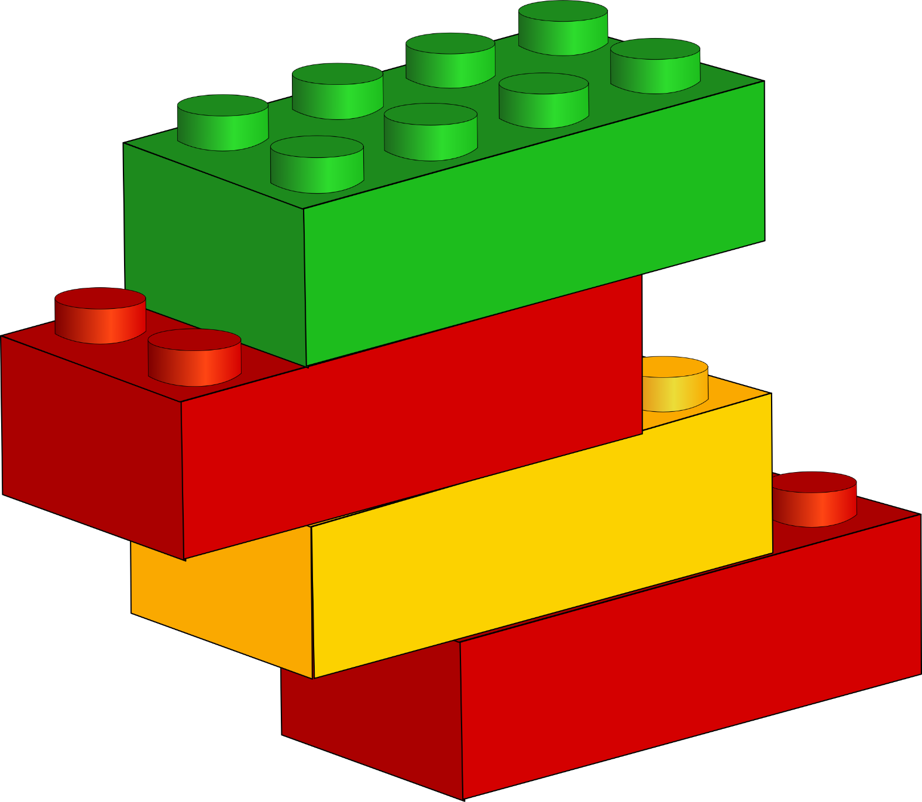
Reading
Phonological
Awareness
Phonemic Awareness
Notes:
Each is a building block of reading. Linked creating a strong foundation for development of future reading skills.

Slide 106

Why is phonemic awareness so critical?

Slide 107

Remember…
Phonemic awareness is not about how
letters and sounds correspond or how
to sound out letters to create words;

Slide 108
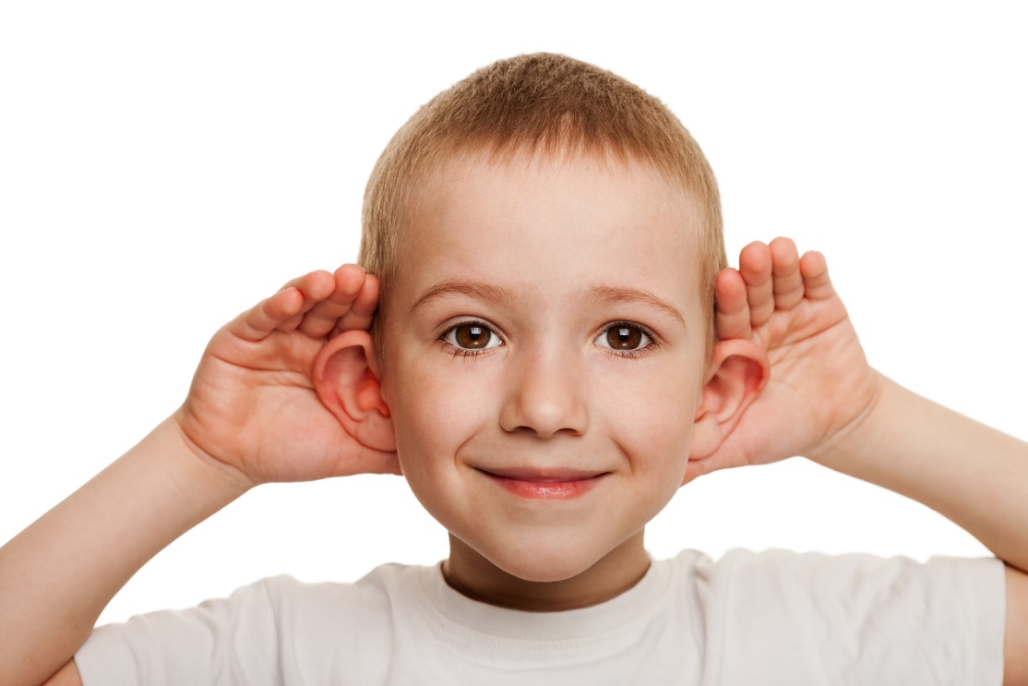
it is hearing, thinking, and
manipulating
individual sounds
within words.

Slide 109
Phonemic awareness, a critical subset of skills in the
larger category of phonological awareness,
is the processing ability
most closely related to early literacy acquisition.
(Anthony & Francis, 2005)

Slide 110
Phonemic awareness is one of the most reliable
predictors of how well children
will learn to read in their first two years
of school.
(Ehri et al., 2001)

Slide 111

Phase Theory

Slide 112
Phase Theory
Pre-alphabetic phase
Full alphabetic phase
Consolidated alphabetic phase
Partial alphabetic phase
(Ehri, 2002, 2004)
Notes:
Pre-Alphabetic--visual cues such as McDonalds
Partial—partial cues and letter sounds first and last letters such a button and balloon
Full—starting to store letter-sound correspondence in memory STOP becomes a sight word stop
Consolidated—chunk of letter-sound correspondence is stored in memory for easy access Do+ing

Slide 113
Pre-Alphabetic Phase
Children read words using visual cues.
Words are remembered by the visual context associated
with the word.
The visual representation may be a picture related to the
word or the shape of the word itself.

Slide 114


Pre-Alphabetic Phase
Environmental print is associated with this
developmental phase including familiar restaurant signs
or a stop sign.

Slide 115
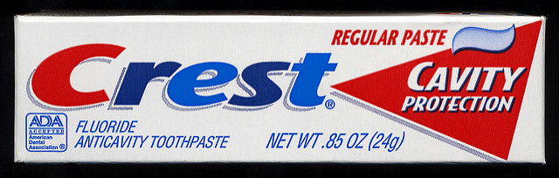
Pre-Alphabetic Phase
In this phase, words are associated with actions.
A young child associates the word “Crest” with the context of brushing teeth.

Slide 116
Pre-Alphabetic Phase
Young children utilize visual cues because they have not developed letter-sound connections.

Slide 117
Partial Alphabetic Phase
Early readers start to acquire letter knowledge
Learning to write their name is a strong predictor of
future reading skills in children
Letters provide concrete phoneme representations that
disappear as soon as they are heard

Slide 118
Partial Alphabetic Phase
Once there are no longer enough visual cues to support a
child’s reading; they move to a combination of cues and
letter knowledge
Children demonstrate quick growth in their sight
vocabulary

Slide 119
Partial Alphabetic Phase
Using either visual cues or partial phonetic cues is
insufficient for reading success
Relying only on visual cues burdens a child’s memory
while phonetic cues also do not always work
B_ _ t braid

Slide 120


Partial Alphabetic Phase
Students often misread similar words because they
are relying on the first and last letter sound while
ignoring the letters in between

Slide 121
Full Alphabetic Phase
Students make connections between letters and sounds
The sound-symbol relationship retained in memory can
be triggered when needed for reading

Slide 122
Full Alphabetic Phase
Learning to read requires recognizing words from
memory through connections between letters and
phonemes
Phonemic awareness is necessary to read words from
memory while also identifying phonemes in unfamiliar
spoken words

Slide 123
Consolidated Alphabetic Phase
The consolidated alphabetic phase leads to further efficiency in
reading
Students have mastered the sound-symbol relationships and
chunk consistent letter groups such as –ing, -ment, and –tion
Decoding words becomes easier with consolidated letter
units

Slide 124
Consolidated Alphabetic Phase
s ing state ment men tion
mix ing frag ment va ca tion

Slide 125

Early language acquisition, phonemic awareness skill development, and teacher professional development each play a critical role in a child’s ability to learn to read.

Slide 126
Activities—Word Counting
  Word counting can be done for any sentence selected from a reading or writing lesson.
  The sentence should be read to the children without being visible.
  The children listen and place a marker from left to right for each word heard.
  The teacher can confirm the number of words by having the children touch their tokens in one-to-one correspondence.

Slide 127
Activities--Word, Syllable, and Phoneme Counting
  Words and syllables are easier to recognize than individual phonemes
  Activities that involve counting the number of words in a sentence or
  syllables in a word can be used as initial steps leading to isolated
  phoneme synthesis and segmentation
  (Lundberg, Frost, & Peterson, 1988)

Slide 128
Phonemic Awareness Activities
Show pictures or point to objects in the room
that are compound words and demonstrate how each
word can be said with a part missing.
Simon says, “say bookmark without the book.”
Simon says, “say hotdog without the dog.”

Slide 129
Activities—Counting Syllables
To count syllables in words, activities can be used such as
clapping hands, tapping the desk, or marching in place to
the syllables

Slide 130
Activities—Sound Segmentation
Segmenting refers to the act of isolating the sounds in a
spoken word by separately pronouncing each one in order
Segmenting the sounds in a word is one of the more difficult
phonemic tasks for children to perform.
Start with initial phonemes as a precursor to segmenting
entire words.

Slide 131
Activities—Sound Synthesis
Sound synthesis or sound blending is an essential skill related to later
reading ability and one of the easiest phoneme awareness tasks for
children to perform
Sound synthesis can be done using the following sequence:
blending an initial sound onto the remainder of a word, followed by
blending syllables of a word together, and then blending isolated
phonemes into a word.

Slide 132
Activities—Sound Synthesis
The teacher can model blending an initial sound onto a
word by using the jingle,
"It starts with /l/ and it ends with ight, put it together, and
it says light."
When they have the idea, the children supply the final
word.

Slide 133
Activities—Sound Synthesis
An element of excitement can be created by using children's names
Ask each child to recognize and say his or her own name when it is
presented — "It starts with /b/ and it ends with etsy, put it together and it
says..."
Context can be provided by limiting the words to objects that can be seen in
the room or to words from a particular story the children just read.
As the children become proficient, they can take turns using the jingle to
present their own words to be blended by the class.

Slide 134
Activities—Sound Deletion
Because sound deletion tasks require manipulation of
phonemes in words, they are considered to be more
difficult than other types of phoneme awareness tasks.
Not until a mental age of approximately 7 years are
children able to perform phoneme deletion tasks
adequately.

Slide 135
Phonemic Awareness Activities
Lewkowicz (1980) suggested that sound deletion activities be
done after the children exhibit some skill in segmentation
and after letter names have been introduced.
Because phoneme deletion of medial consonants puts an
undue burden on young children's memory, sound deletion
should target only initial or final sounds in words.

Slide 136
Phonemic Awareness Activities
What’s the Missing Sound?
“Meat” “Eat”
“Boat” “Oat”

Slide 137
Activities—Letter/Sound Association
All phoneme awareness activities that use tokens or other
visual representations of sounds can be modified to
include letter-sound associations.
As individual sounds are mastered by the children, their
corresponding letter names can be introduced and placed
on the tokens and gradually introduced into the
segmentation activities.

Slide 138
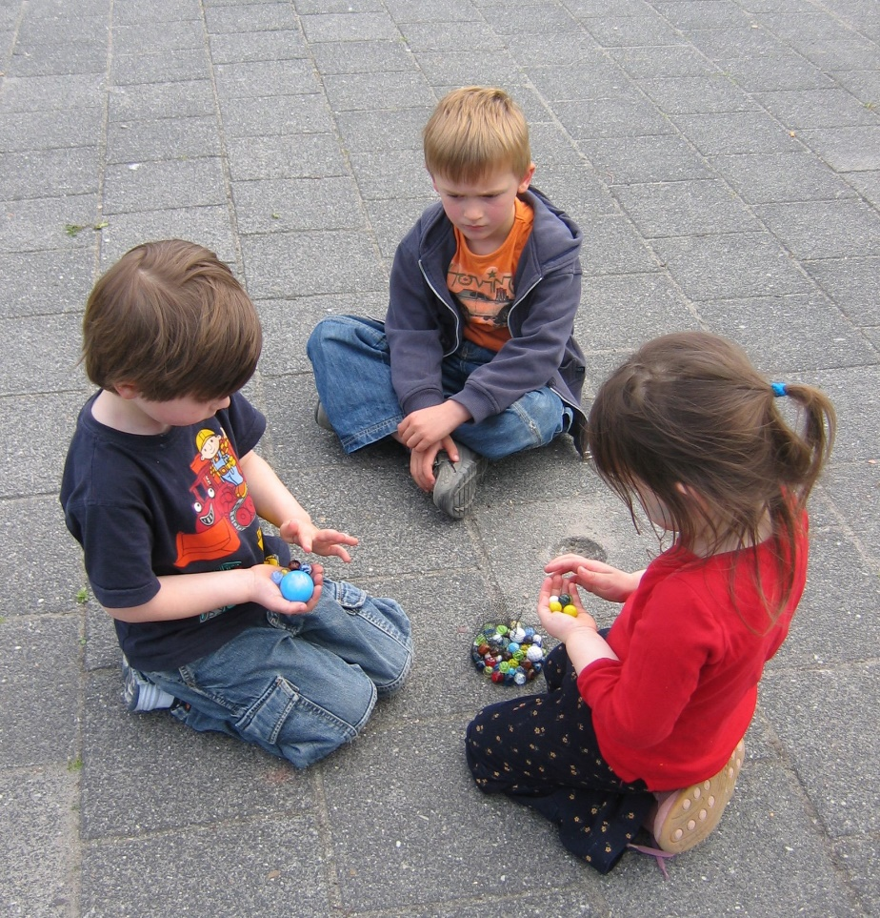
Let’s Look at Some Activity Ideas…

Slide 139
In Closing…
Struggling readers first have difficulty understanding how words in oral language are represented in print
and secondly,
making the connections between the sounds in words
and the letters representing them.

Slide 140

Implications for Professional Practice
Evidence exists that teachers can increase their knowledge of phonemic awareness in a brief timeframe following instruction of phonemic awareness concepts.

Slide 141

There are a multitude of factors which impact a student’s ability to learn and a teacher’s ability to teach.
Reading remains critical to personal and professional success, so educators must continue to seek answers to these questions.
Notes:
The Survey of Teacher PhAKS (Phonemic Awareness, Knowledge, and Skills) included nine items assessing teacher knowledge about phonemic awareness instruction with the first six items containing a foil which was an answer better describing phonics (Cheesman et al., 2009). The last six items in the survey assessed key skills in phonological awareness.

Slide 142
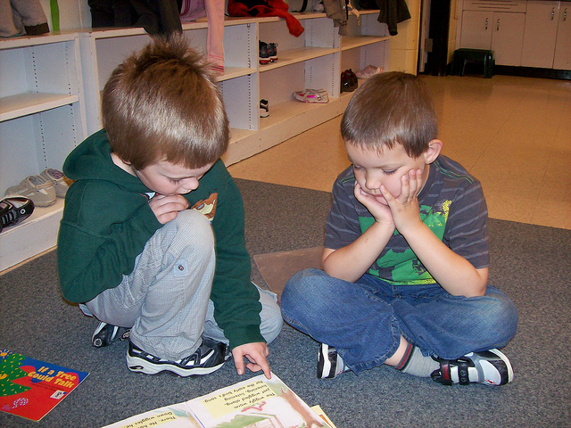
Thank You!
Dana Harris
harrisdm@puyallup.k12.wa.us

